Slide 1
Uma história de analytics e automação Walid Radwan Diretor Global Customer Operations Data & Analytics 3M Company

Slide 2
- Quem aqui está dentro da organização de TI em sua empresa?

Slide 3
- Quem aqui está dentro da organização de TI em sua empresa? - Quem aqui TRABALHA COM MAPEAMENTO DE PROCESSOS?

Slide 4
"The first rule of any technology used in a business is that automation applied to an efficient operation will magnify the efficiency.”
1

Slide 5
"The first rule of any technology used in a business is that automation applied to an efficient operation will magnify the efficiency.”
1
“The second is that automation applied to an inefficient operation will magnify the inefficiency."
2

Slide 6
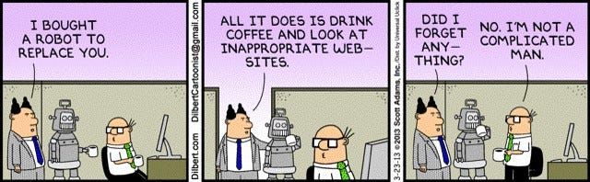

Slide 7
CONTEXTO na 3m

Slide 8
Intelligent
Defects
Prescriptive
Six Sigma
Predictive
Lean
Diagnostic
Descriptive
Design Thinking
Data

Slide 9
O lado de analytics

Slide 10
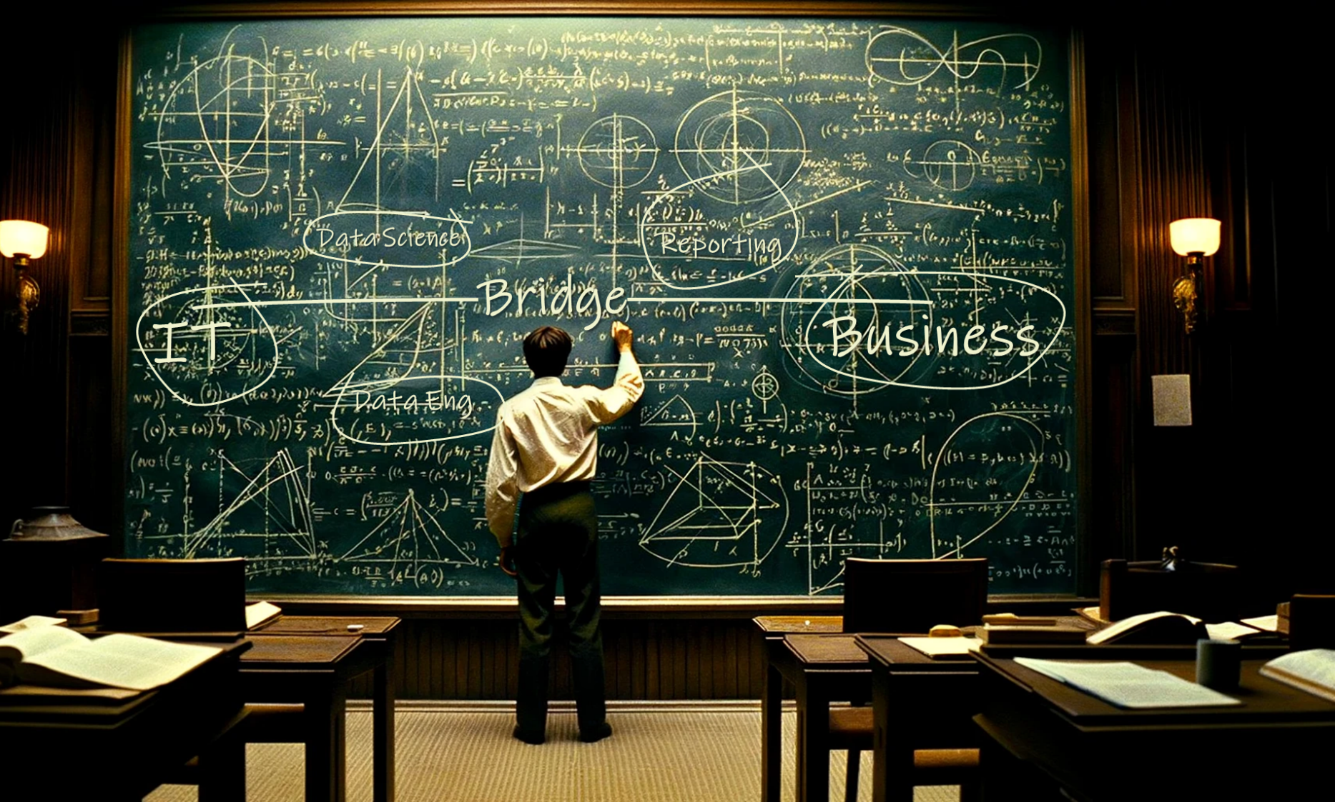

Slide 11

Push to Go

Slide 12
A MUDANÇA

Slide 13

Automation
GenAI
Analytics

Slide 14
A NOVA DOR

Slide 15
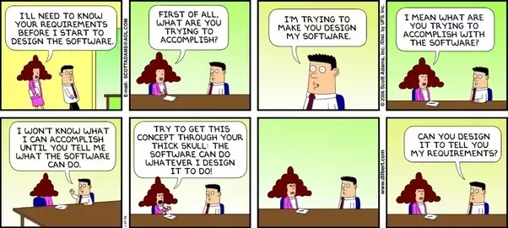

Slide 16
A SOLUÇÃO

Slide 17

PROCESS IMPROVEMENT
AUTOMATION

Slide 18
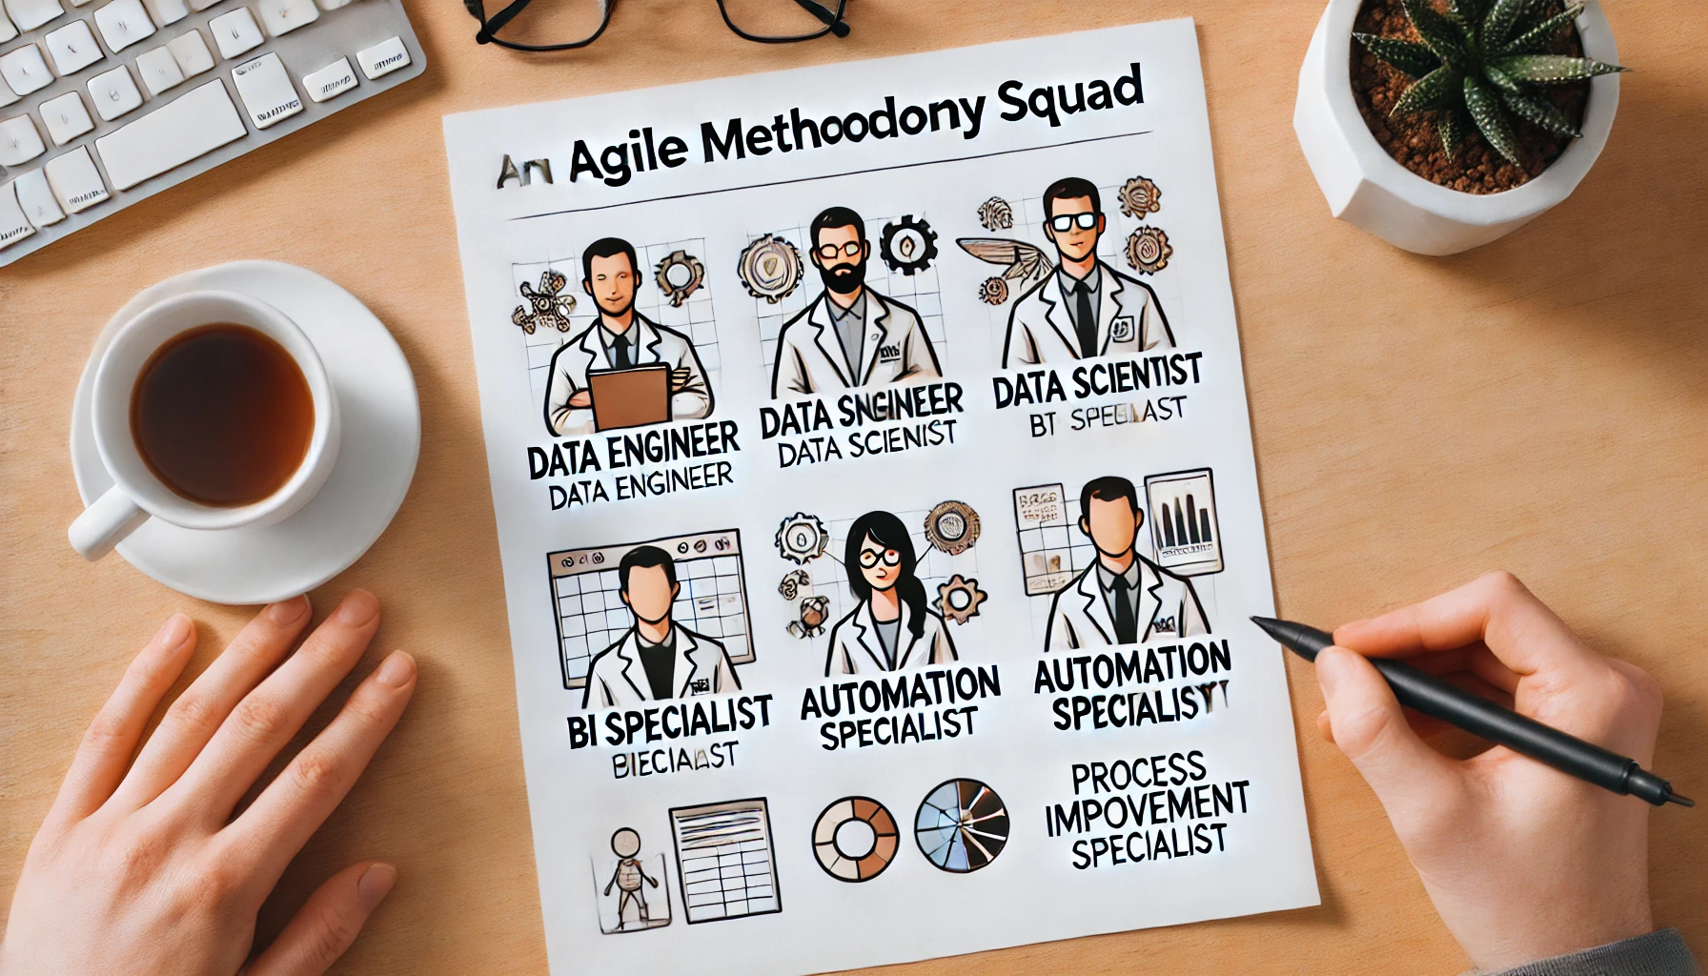
AGILE METHODOLOGY SQUAD
DATA SCIENTIST
DATA ENGINEER
PROC IMPROV SPECIALIST
AUTOMATION SPECIALIST
BI SPECIALIST

Slide 19
Conhecem esse ‘algoritmo’?

Slide 20
1
Question every requirement.
2
Delete any part or process you can.
3
Simplify and optimize.
4
Accelerate cycle time.
5
Automate.

Slide 21
OBRIGADO
WALID RADWAN
+55 19 996062857
wwradwan@mmm.com

